Slide 1
Earthquake Analyzer

Slide 2
Objectives
Analyze and Display the data in a graphical form
Retrieve Data from the accelerometer

Slide 3
Android Software Capability
Storage of Data
Analysis

Slide 4
Paper Prototype

Slide 5
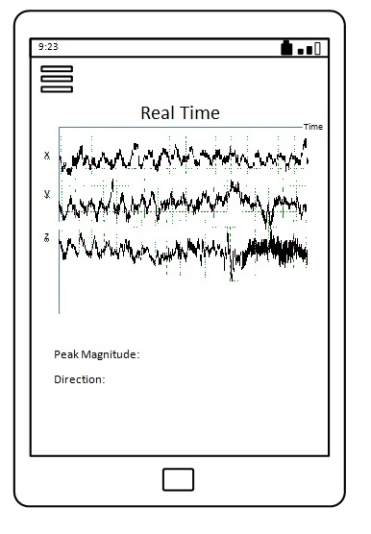
Paper Prototype (MainPage)

Slide 6
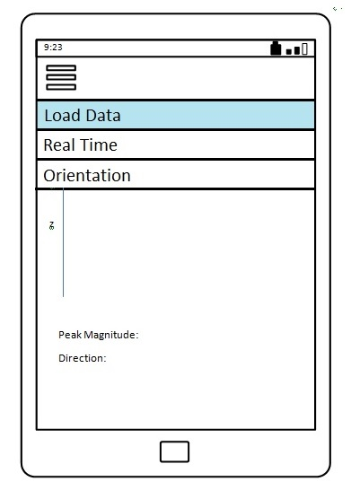
Paper Prototype (DropDownPage)

Slide 7
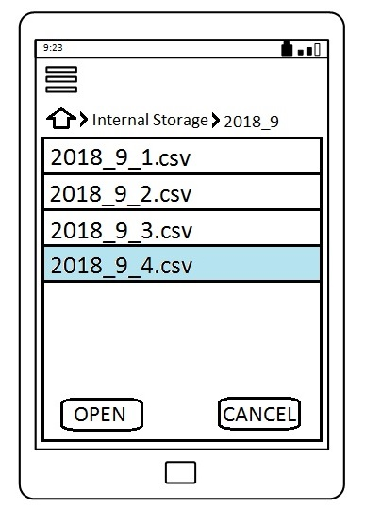
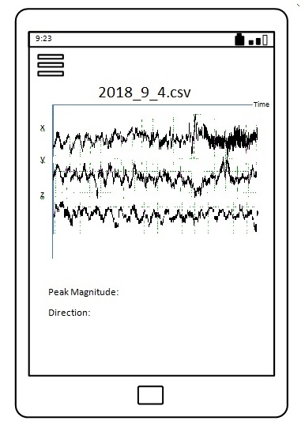
Paper Prototype (LoadPage)

Slide 8
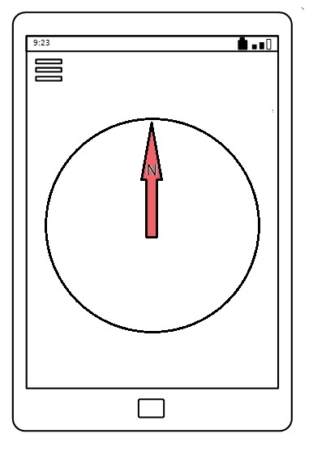
Paper Prototype (CompassPage)

Slide 9
UseCase

Slide 10
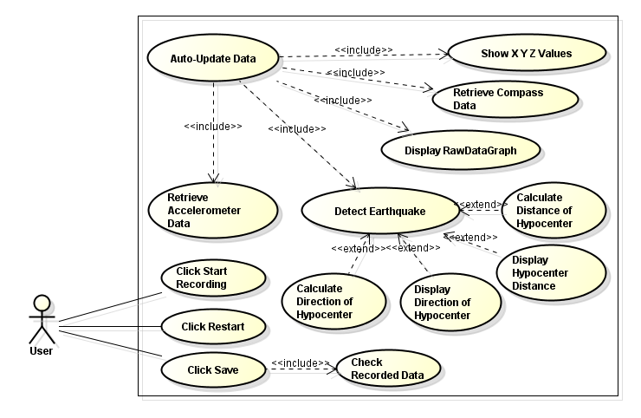
UseCase (Real Time)

Slide 11
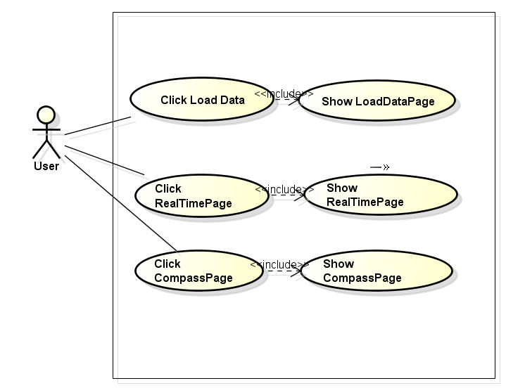
UseCase (DropDownPage)

Slide 12
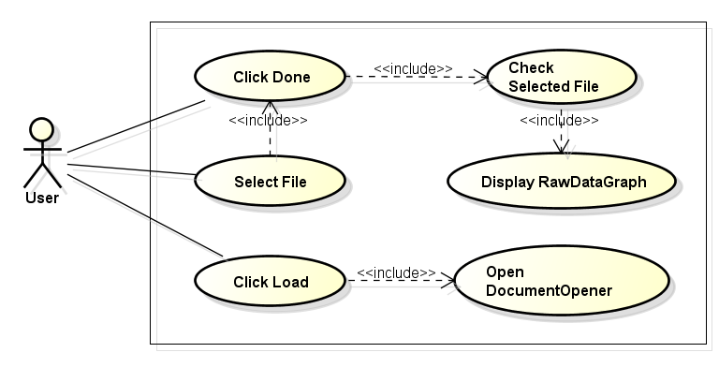
UseCase (LoadPage)

Slide 13
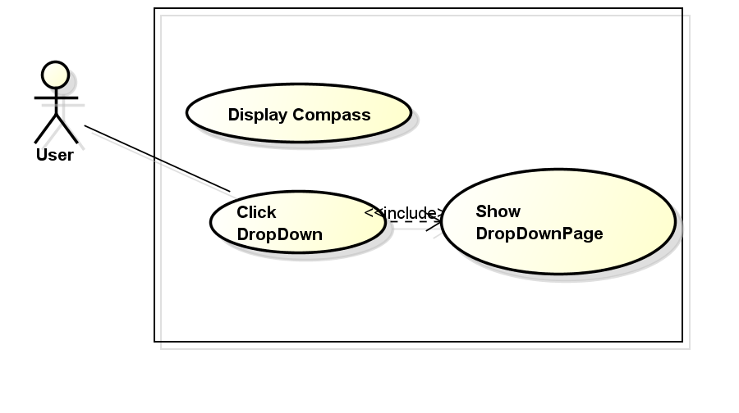
UseCase (CompassPage)

